Slide 1
Introduction to Tableau
Part 5
Notes:
Welcome back to Data Society! We have a great class ahead of us today.

Slide 2
Recap
Aggregating by formula
Sorting
Attributes
Binning continuous data
Grouping by category
Cleaning and focusing with filters
Match value
Top values
Ranges
Notes:
The purpose of this slide is to recap the topics discussed during the last session. ASK if anyone has any questions about these topics before moving on.

Slide 3
Save your work!
Beginning in this module, we will be creating more elaborate visualizations.
We will see a lot of different insights from the data as we learn more in Tableau.
Make sure to save all your classwork (including Exercises), because we will be putting it all together at the end of the unit to create a story.
Notes:
The purpose of this slide is to remind students to begin regularly saving their work. The data visualizations produced in class and during Exercises will be the basis of a final dashboard and story they will put together at the end of the unit. REMIND students that they should get in the habit of saving work regularly.

Slide 4
Warm-up: other data sources
In a previous module, we explored Kaggle and Data.World, but there are plenty of other public datasets out there available for use and experimentation.
Have a look at the list at the following address: https://github.com/awesomedata/awesome-public-datasets
Which datasets might you like to explore?
Notes:
The purpose of this slide is to invite students to explore a large list of publicly available datasets and to consider their ideas about their Capstone project datasets they should be thinking about this week. Allow students 5-7 minutes to peruse the list. Then ASK students to share some of their observations via chat or via microphone and COMMENT on their responses. This activity should take approximately 10 minutes total.

Slide 5
Module completion checklist
Objective | Complete
Discuss formatting options in Tableau
Explain the concept of functions
Implement basic functions on the dataset
Introduction to table calculations

Slide 6
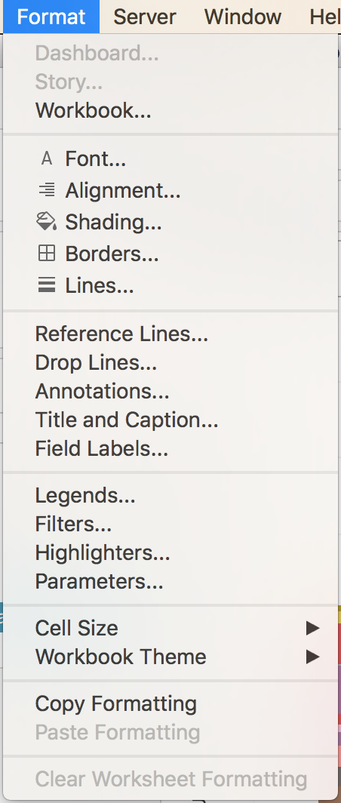
Formatting your figures
Open the formatting pane with the “Format” menu.
The formatting pane is contextual, meaning it changes based on what is highlighted.
Notice the different elements Tableau will let you format, from font and line type, to annotations, to labels and legends.
Notes:
The purpose of this slide is to introduce the Format menu in Tableau. WALK THROUGH some of the different options / sub-menus so that students get a feel for what kinds of elements and parameters can be customized.

Slide 7
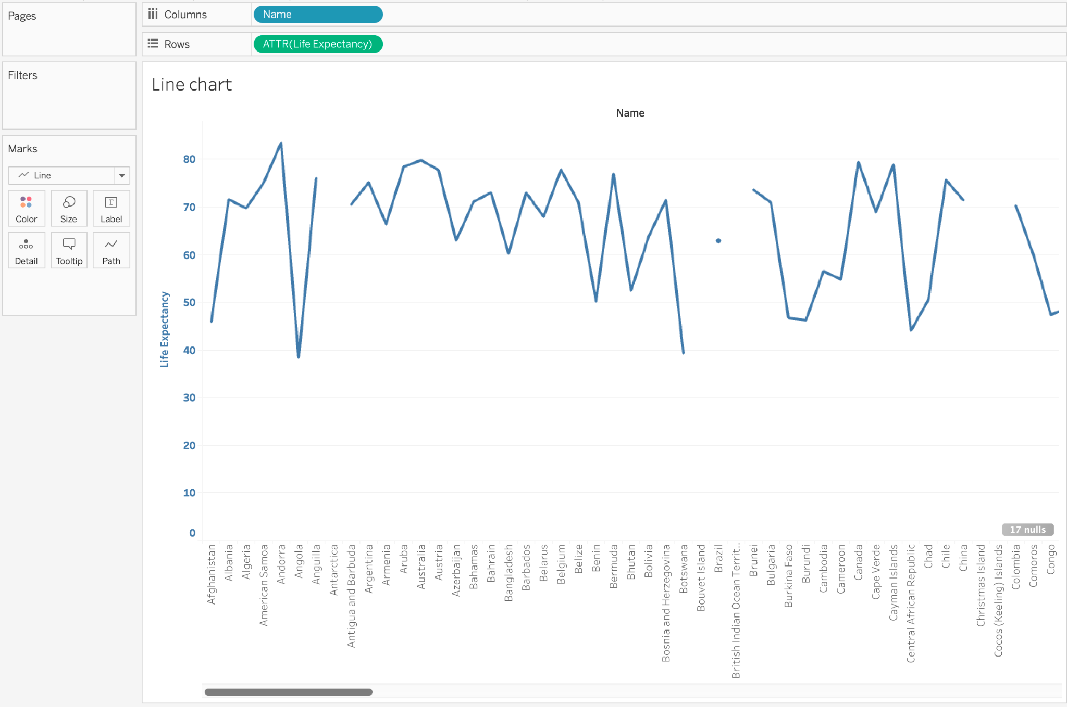
Formatting your figures
Let’s start with the line chart that we made for showing life expectancy.
What would you do to improve this?
What is being shown here? What aspects are most important?
Can you think of any existing variable that would add insight?
Now what about font and colors?
Notes:
The purpose of this slide is to get students thinking about how to improve a visualization. INSTRUCT students to pull up the line chart from the last session. If students do not have this readily available, WALK THROUGH how to reconstruct the plot. Then ASK students the questions on the slide and COMMENT on their responses.

Slide 8
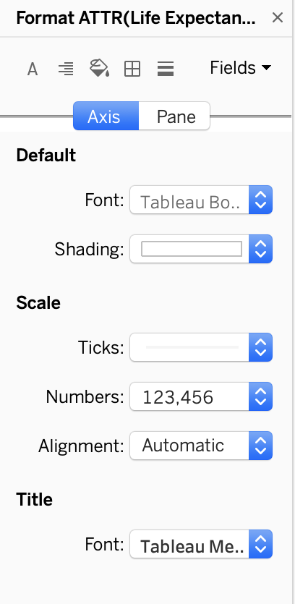
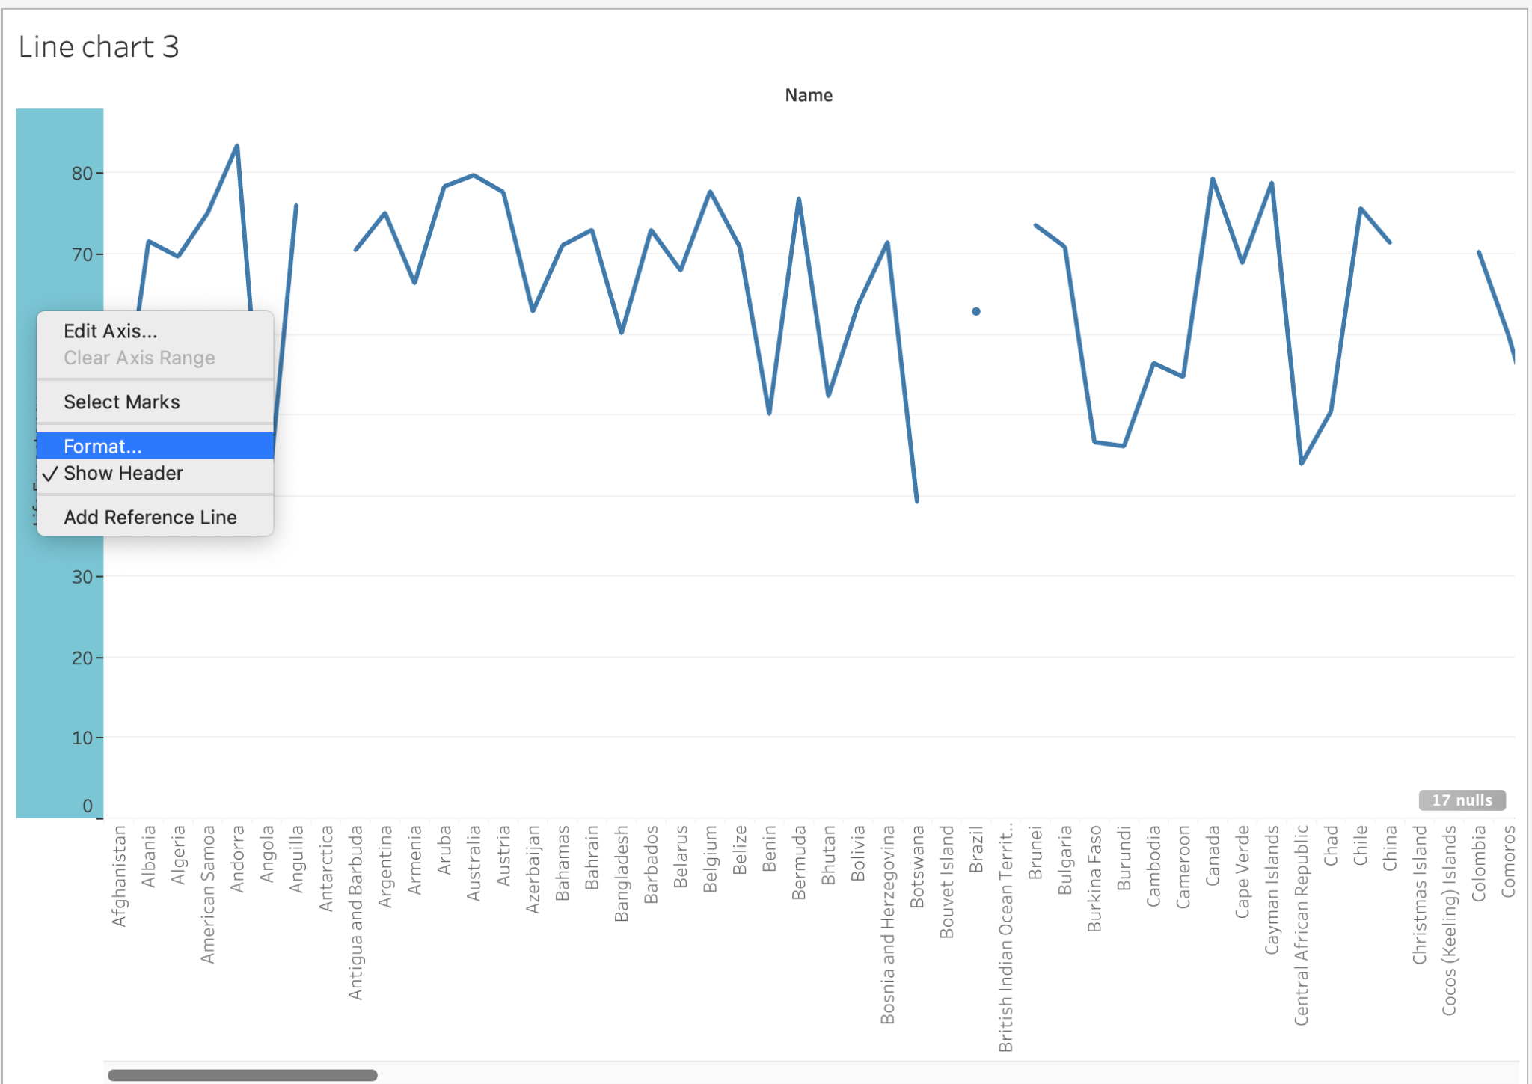
Formatting: right-clicking an element
In addition to using the Format menu, we can open the formatting pane by right-clicking on any view element.
Start by selecting the y axis of our “Life expectancy” view.
Note that the contextual format pane pops up on the left.
Notes:
The purpose of this slide is to introduce right-clicking to open the formatting pane and to begin formatting the line chart.

Slide 9
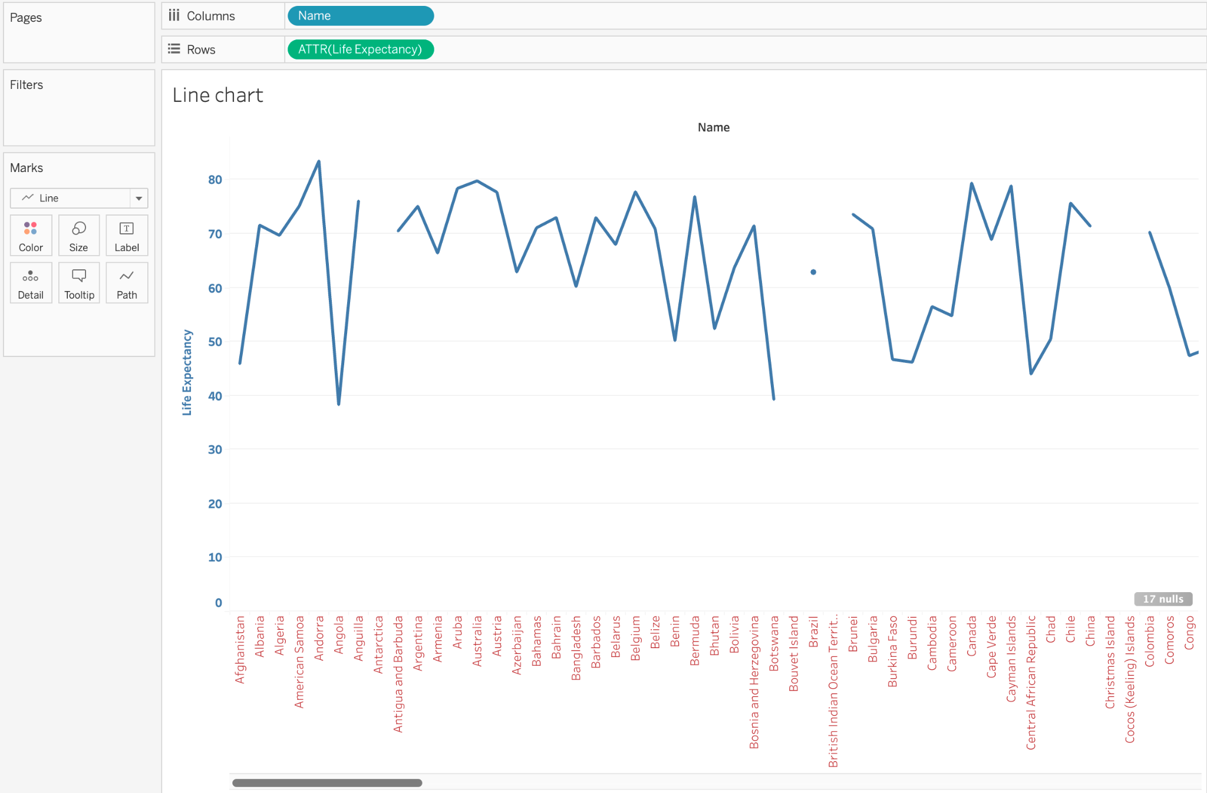
Formatting: customizing an axis
Let’s change the font, size and color of the axis.
Experiment with these elements in order to:
Make the numbers easier to read.
Make the year stand out.
What kinds of changes did you make?
Notes:
The purpose of this slide is to implement a couple of changes to the line chart. INSTRUCT students to experiment with some options for making the numbers easier to read and making the year stand out. ASK what kinds of changes they made and COMMENT (constructively) on their experiments.

Slide 10
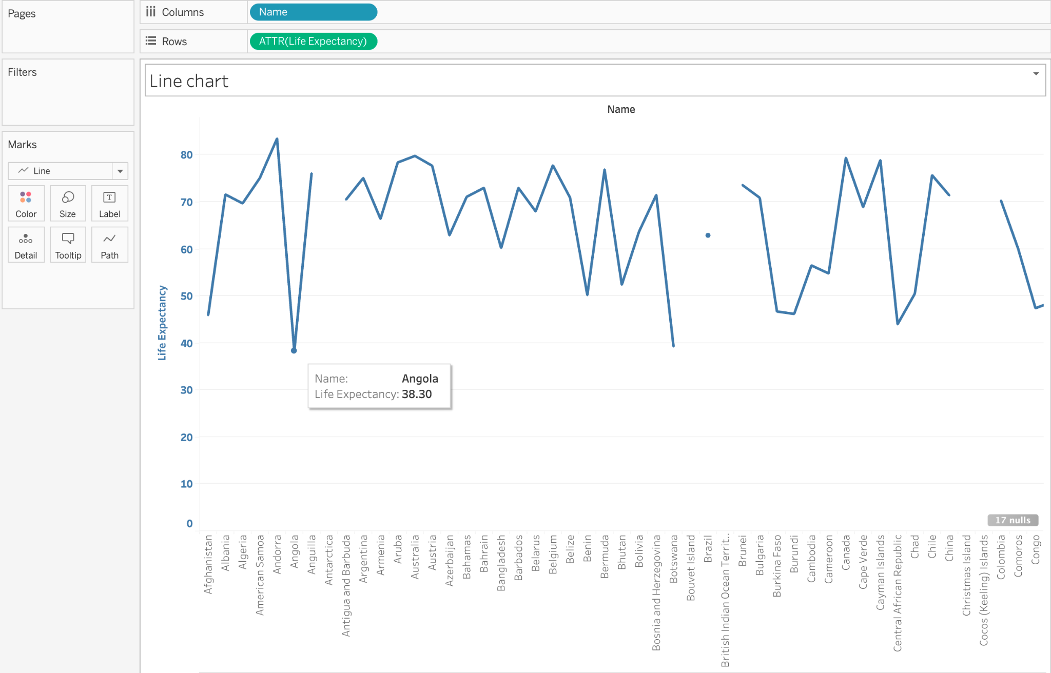
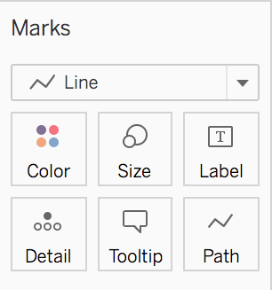
Formatting: the Marks card
The marks card is a powerful tool that allows you to add “marks.”
Marks visually highlight certain features of the data.
We’ve started with a very basic version of this figure with no marks.
Notes:
The purpose of this slide is to introduce the Marks card. POINT OUT its location within the Tableau GUI and WALK THROUGH how each of the 7 options affect the chart.
Steps for formatting:
Click on drop down beside the line on the marks card and change the type of chart to bar type.
Drag and drop the country name into the color tab on the marks card
Drag and drop the life expectancy into the labels tab of marks card to display the life expectancy explicitly on the bar chart (make sure life expectancy is considered as an attribute)

Slide 11
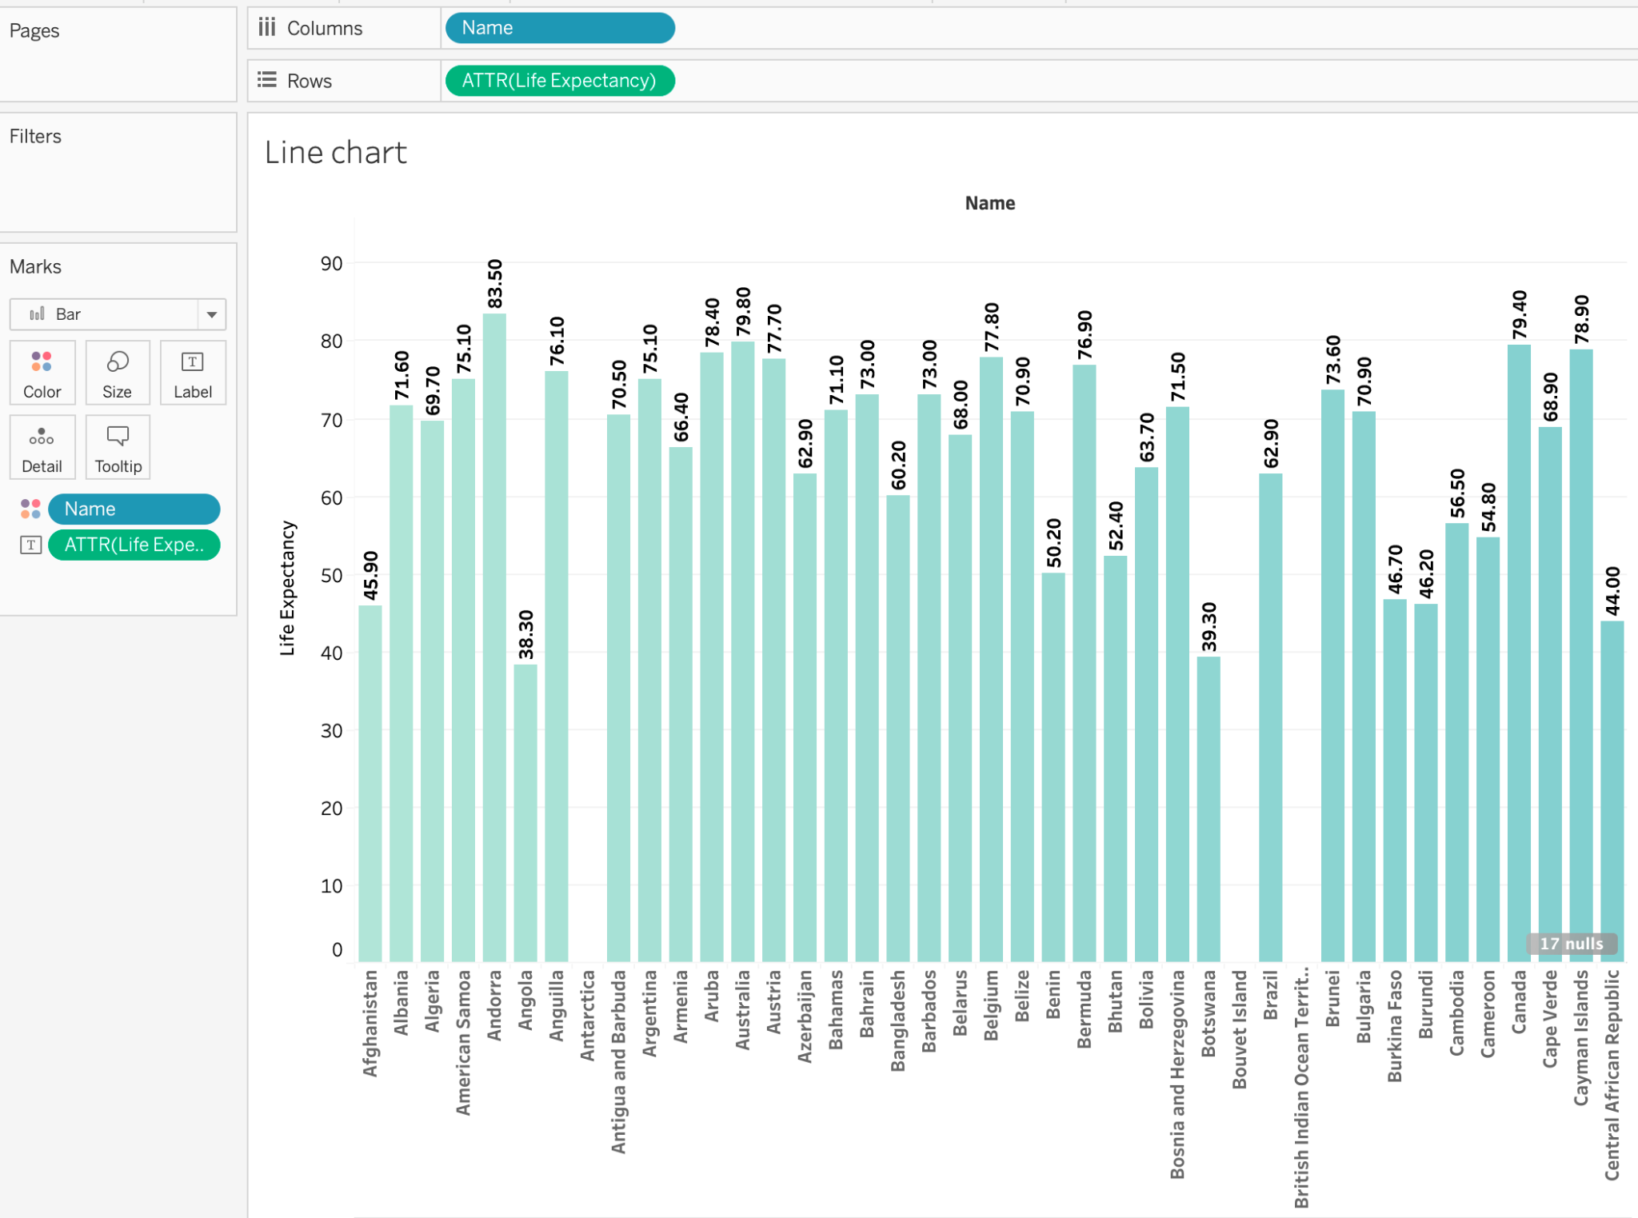
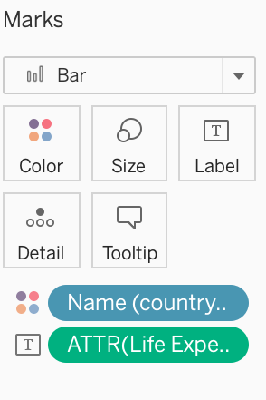
Formatting: the Marks card, cont’d.
With 3 changes to the Marks card, we can:
Produce a visually interesting color
Add a count label
Convert the line chart into a bar chart appropriate for discrete events
Notes:
The purpose of this slide is to substantially alter the line chart in just a few clicks. WALK THROUGH precisely how to change each of these attributes: the color, the label, the chart type.
Steps for formatting:
Click on drop down beside the line on the marks card and change the type of chart to bar type.
Drag and drop the country name into the color tab on the marks card
Drag and drop the life expectancy into the labels tab of marks card to display the life expectancy explicitly on the bar chart (make sure life expectancy is considered as an attribute)

Slide 12
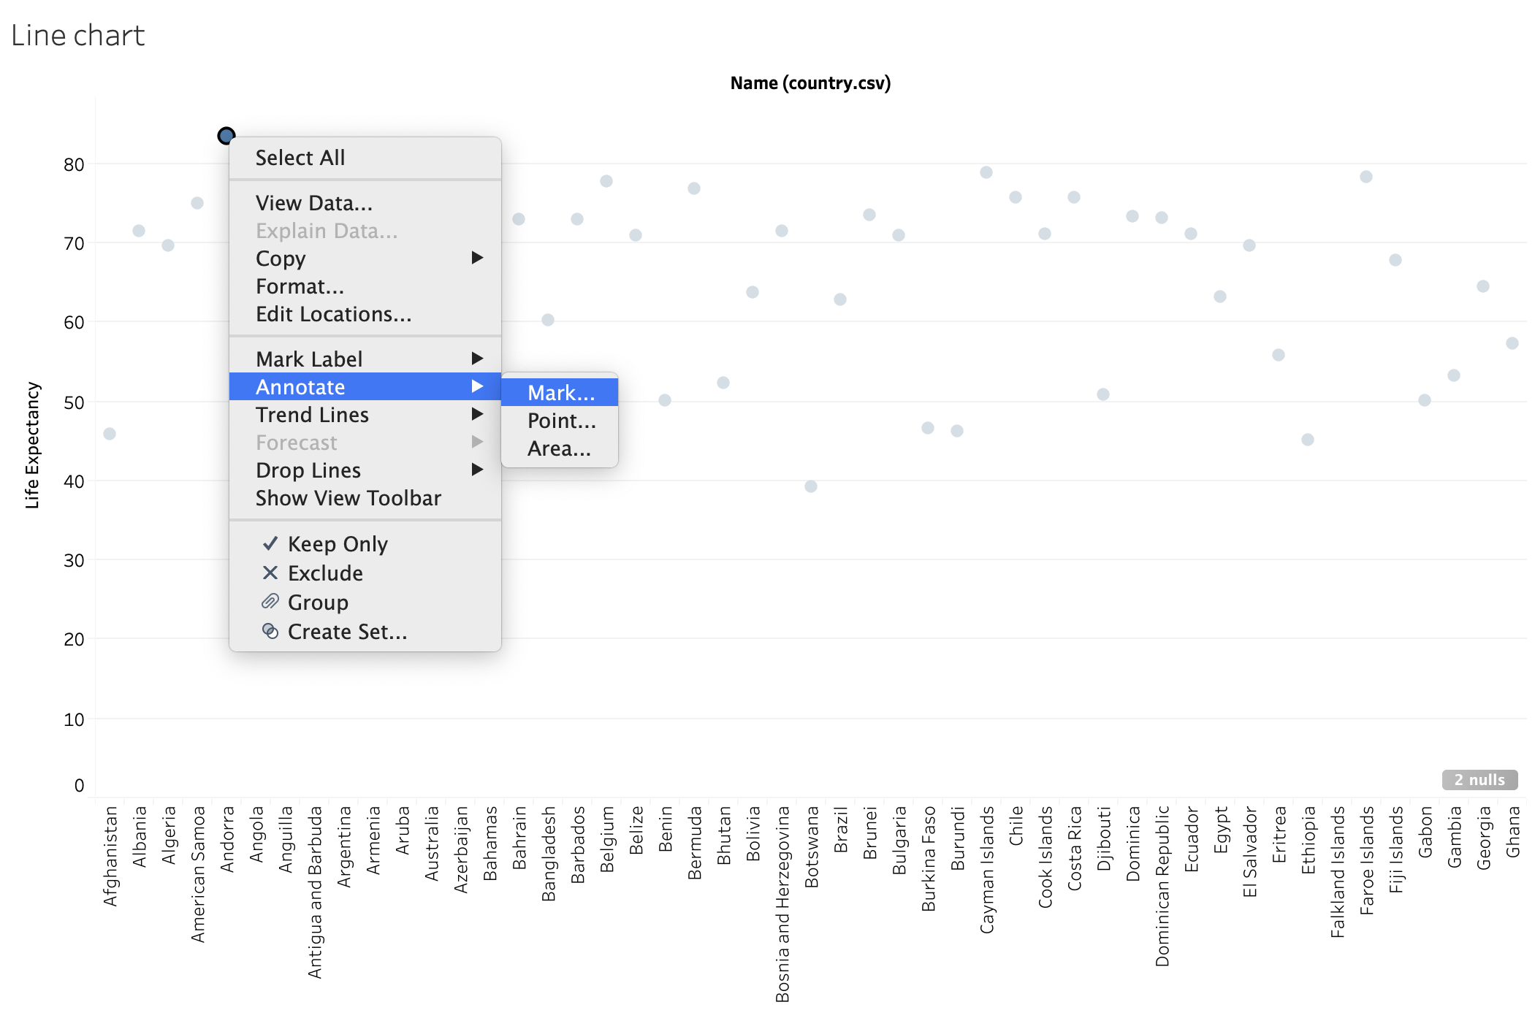
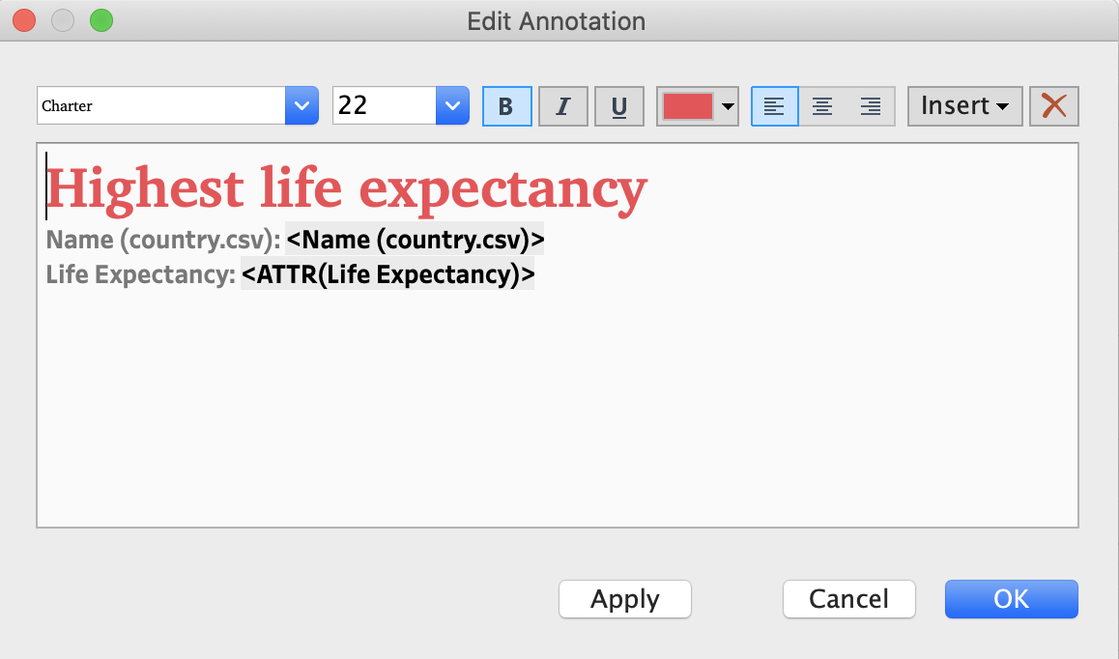
Annotating a point
Let’s use the Marks card to convert the bar chart to a point chart.
Then, add an annotation to the country with the highest life expectancy by right-clicking on the point with highest life expectancy.
Add a call-out by annotating with a mark.
Add a custom header.
Customize the data that is shown in the annotation.
Notes:
The purpose of this slide is to explain how to add an annotation to a Mark. WALK THROUGH how to make modifications in the Edit Annotation panel.
Time permitting, distinguish between what it means to Annotate a Mark, a Point, and an Area.
Steps for formatting:
To convert the bar chart to point chart, click on the drop down list within the marks card and change it to circle type.

Slide 13
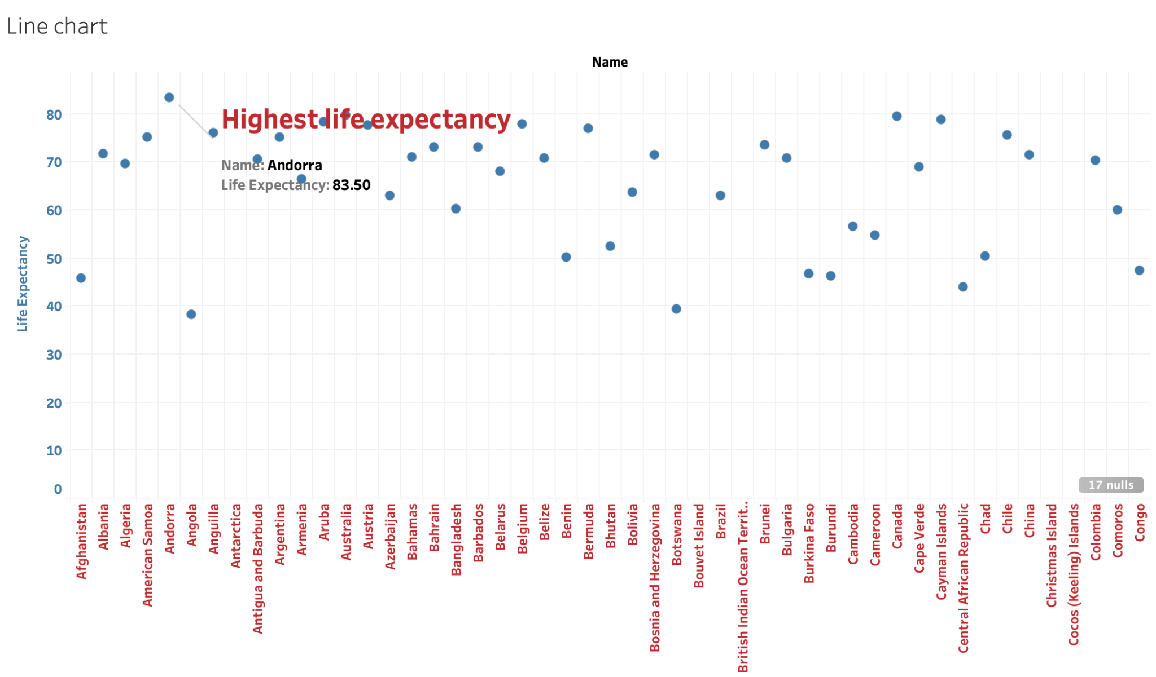
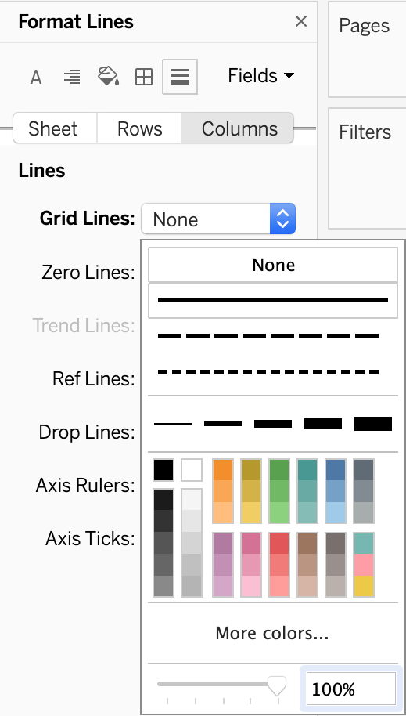
Formatting: annotate Marks
Finally, add some grid lines to the figure space.
Notes:
The purpose of this slide is to WALK THROUGH how to add grid lines to a figure and how to edit the tool tip.
To add grid lines to the chart -
1. Click on Format chart
2. Select the option lines from the set of icons available in the format section.
3. Now expand grid lines and add them to your chart

Slide 14
Knowledge check 5

Slide 15
Exercise 5

Slide 16
Module completion checklist
Objective | Complete
Discuss formatting options in Tableau
Explain the concept of functions
Implement basic functions on the dataset
Introduction to table calculations

Slide 17
End of Part 5

